Slide 1



Introduction to Git and GitHub

Slide 2
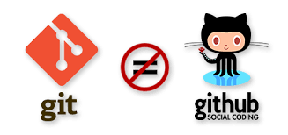
Outline
I. Introduction to source control
A. History and fundamental concepts behind source control
B. Centralized vs. distributed version control
II. Introduction to Git
A. What is Git? Basic Git concepts and architecture
B. Git workflows: Creating a new repo (adding, committing code)
C. HEAD
D. Git commands (checking out code)
E. Master vs branch concept
F. Creating a branch/switching between branches
G. Merging branches and resolving conflicts
III. Introduction to GitHub
A. What is GitHub? Basic GitHub concepts
B. GitHub in practice: Distributed version control
C. Cloning a remote repo
D. Fetching/Pushing to a remote repo
E. Collaborating using Git and GitHub

Slide 3
What is a ‘version control system?’
a way to manage files and directories
track changes over time
recall previous versions
‘source control’ is a subset of a VCS.

Slide 4


Some history of source control…
(1972) Source Code Control System (SCCS)
- closed source, part of UNIX
(1982) Revision Control System(RCS)
- open source
(1986) Concurrent Versions System (CVS)
- open source
(2000) Apache Subversion (SVN)
- open source

Slide 5

…more history
(2000) BitKeeper SCM
- closed source, proprietary, used with
source code management of Linux kernel
- free until 2005
- distributed version control

Slide 6
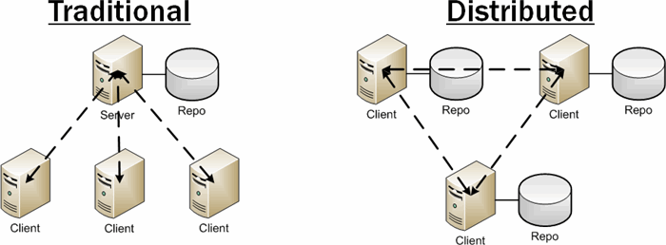
Distributed version control
No central server
Every developer is a client, the server and the repository
Source: http://bit.ly/1SH4E23

Slide 7
What is git?

Slide 8

What is git?
created by Linus Torvalds, April 2005
replacement for BitKeeper to manage Linux kernel changes
a command line version control program
uses checksums to ensure data integrity
distributed version control (like BitKeeper)
cross-platform (including Windows!)
open source, free

Slide 9
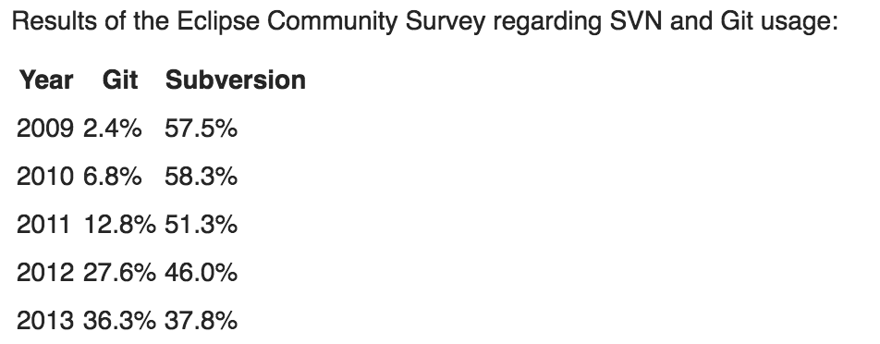
Popularity
https://www.openhub.net/repositories/compare
http://bit.ly/1QyLoOu
http://www.indeed.com/jobtrends/q-svn-q-git-q-subversion-q-github.html?relative=1

Slide 10
Git distributed version control
“If you’re not distributed, you’re not worth using.” – Linus Torvalds
no need to connect to central server
can work without internet connection
developers can work independently and merge their work later
every copy of a Git repository can serve either as the server or as a client (and has complete history!)
Git tracks changes, not versions

Slide 11

Is Git for me?
People primarily working with source code
Anyone wanting to track edits (especially changes to text files)
- review history of changes
- anyone wanting to share, merge changes
Anyone not afraid of
command line tools

Slide 12
Most popular languages used with Git
HTML
CSS
Javascript
Python
ASP
Scala
Shell scripts
PHP
Ruby
Ruby on Rails
Perl
Java
C
C++
C#
Objective C
Haskell
CoffeeScript
ActionScript

Slide 13
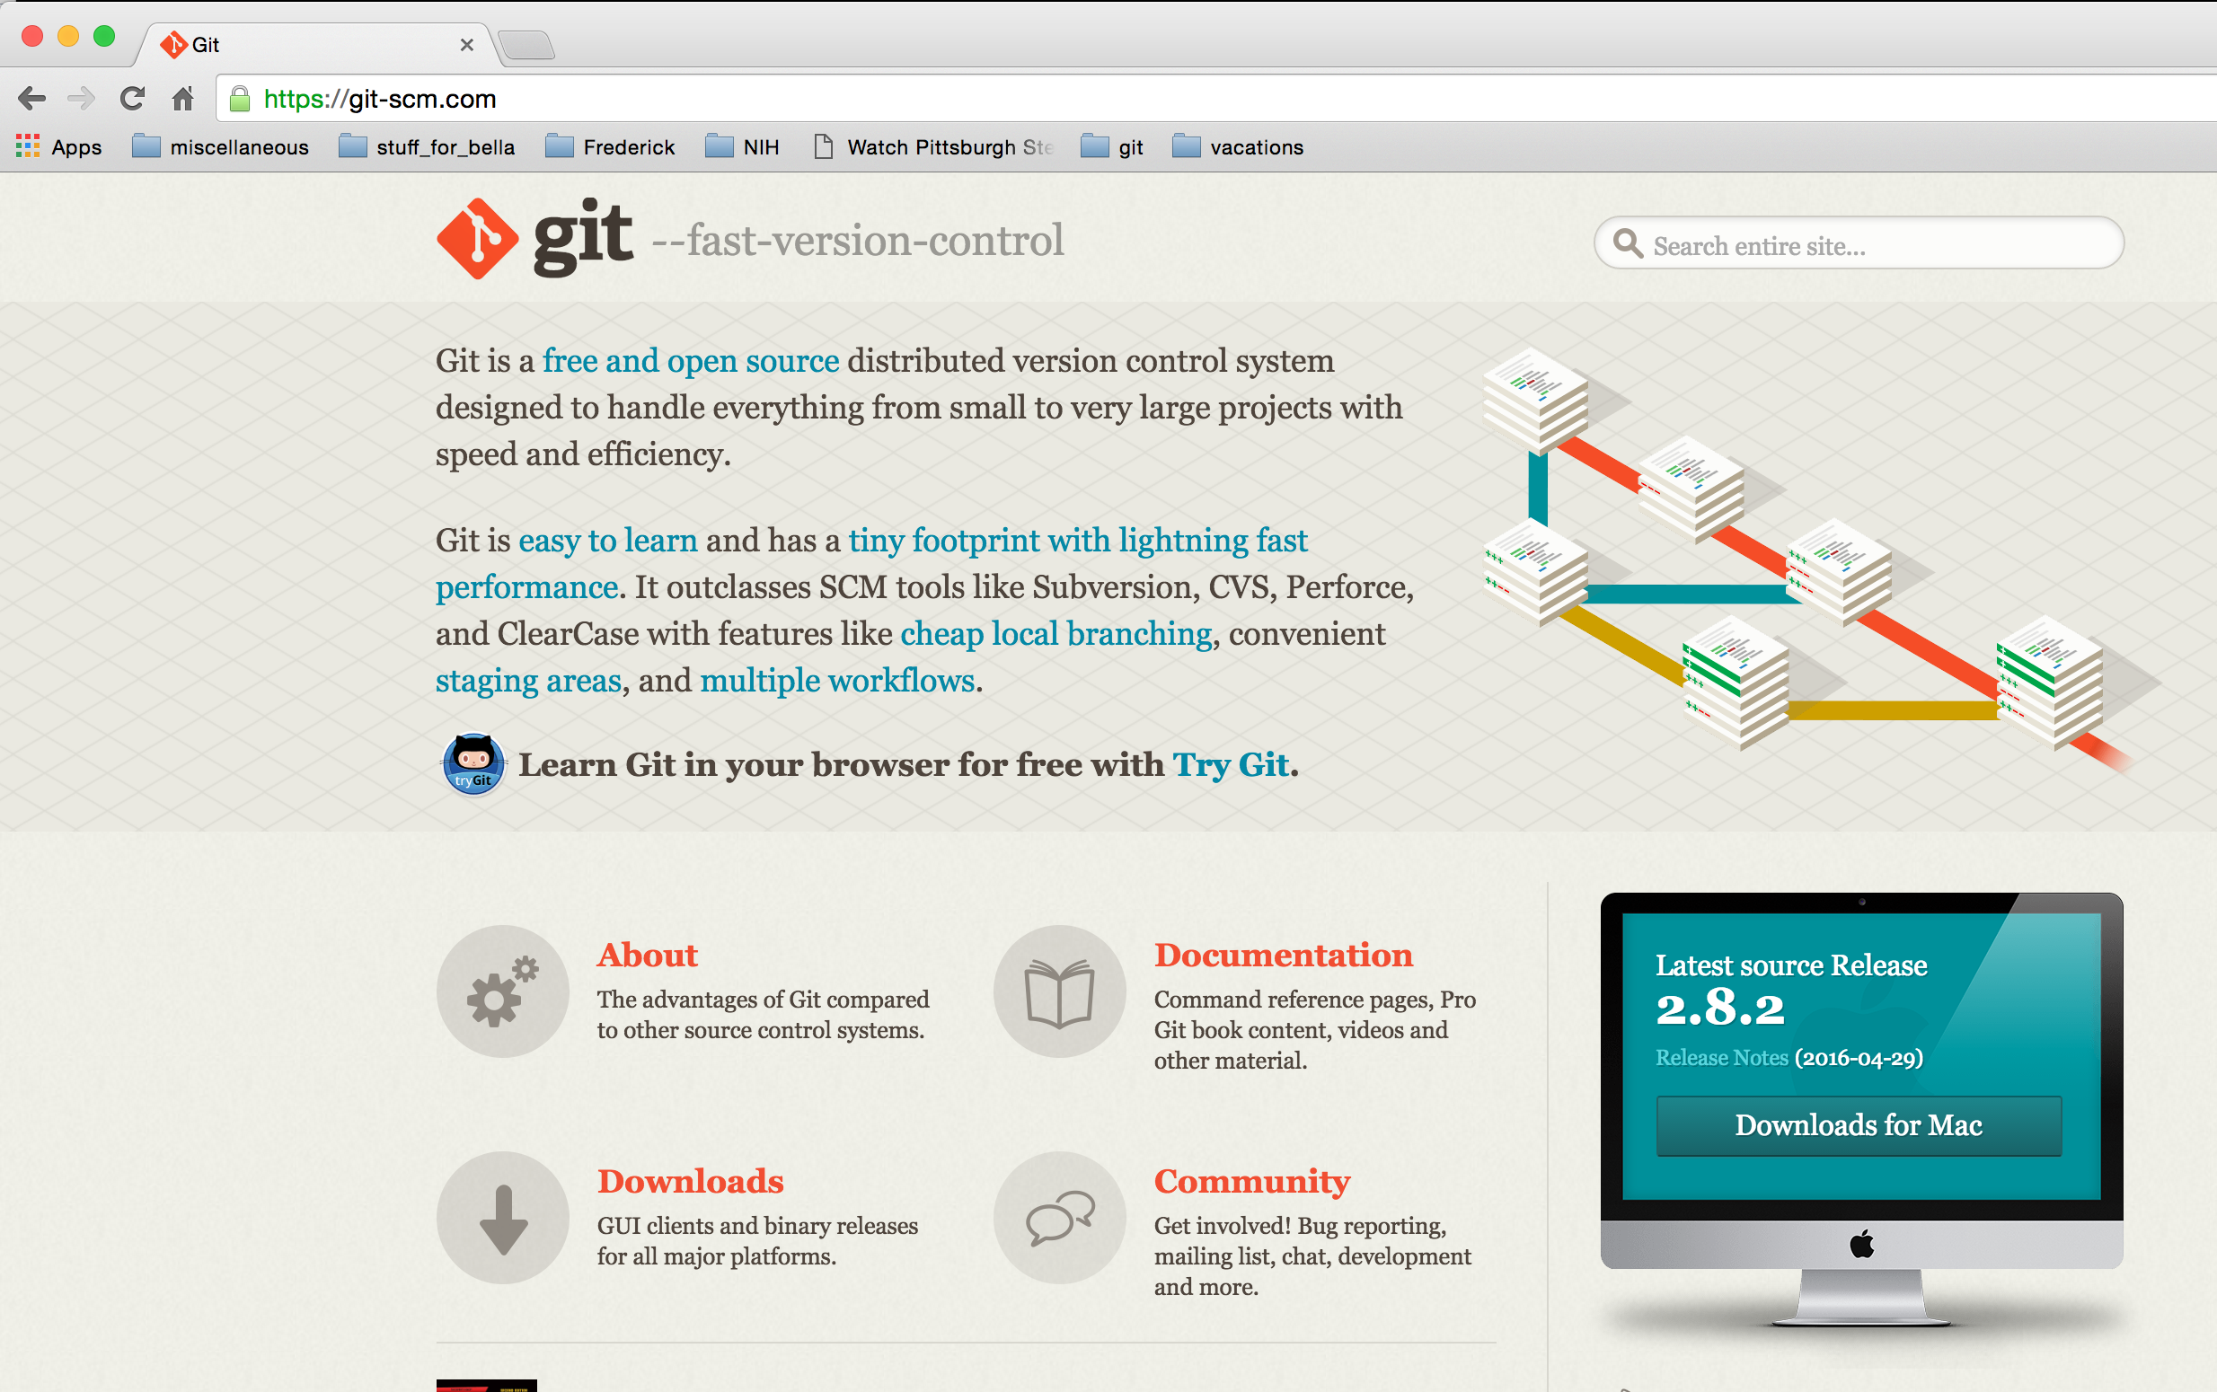
How do I get it?
http://git-scm.com

Slide 14
Git install tip
Much better to set up on a per-user basis (instead of a global, system-wide install)

Slide 15
What is a repository?
“repo” = repository
usually used to organize a single project
repos can contain folders and files, images, videos, spreadsheets, and data sets – anything your project needs

Slide 16
Two-tree architecture
other VCSs
Repository
checkout
commit
working

Slide 17
Git uses a three-tree architecture
Repository
commit
Staging index
checkout
add
working

Slide 18
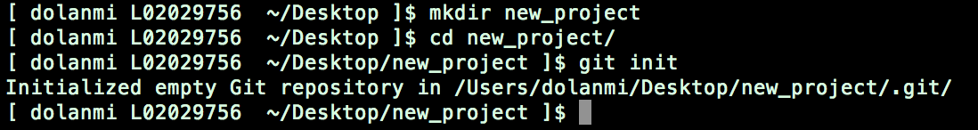
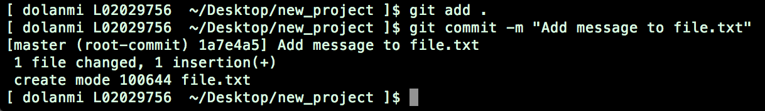
A simple Git workflow
Initialize a new project in a directory:
git init
2. Add a file using a text editor to the directory
3. Add every change that has been made to the directory:
git add .
Commit the change to the repo:
git commit –m “important message here”
.

Slide 19
After initializing a new git repo…
3. Commit changes with
a message
2. Add changes
1. Make changes
Repository
commit
Staging index
add
working

Slide 20
A note about commit messages
Tell what it does (present tense)
Single line summary followed by blank space followed by more complete description
Keep lines to <= 72 characters
Ticket or bug number helps

Slide 21
Good and bad examples
Bad: “Typo fix”
Good: “Add missing / in CSS section”
Bad: “Updates the table. We’ll discuss next
Monday with Darrell.”

Slide 22
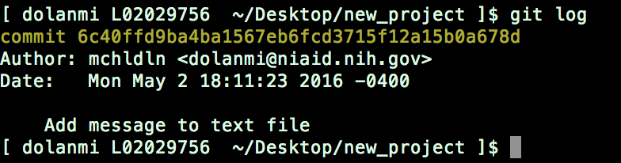
How to I see what was done?
git log

Slide 23
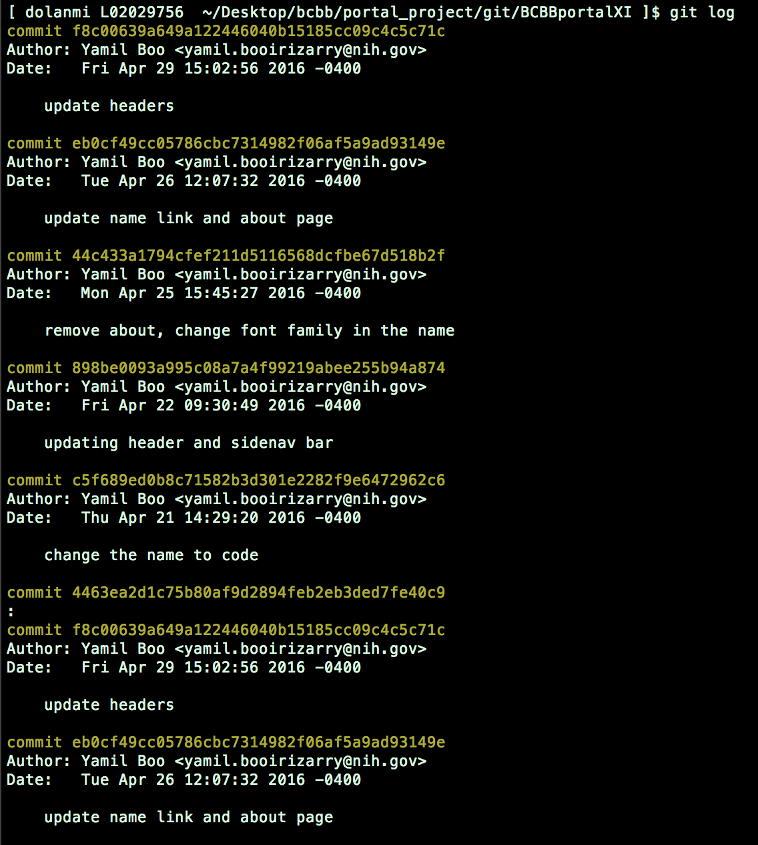
“SHAs”
Checksums
generated by
SHA1
encryption
algorithm
Notes:
One can log in in the morning and see what has been done and by who.

Slide 24

The HEAD pointer
points to a specific commit in repo
as new commits are made, the pointer
changes
HEAD always points to the “tip” of the
currently checked-out branch in the repo
(not the working directory or staging index)
last state of repo (what was checked out initially)
HEAD points to parent of next commit (where writing the next commit
takes place)

Slide 25
Last commit
Parent of
Parent of
Parent of
master
Y4f7uiPRRo…
Pu87rRi4DD..
Qs2o0k64ja…
i7Ewd37kL9…
HEAD
branch
9i5Tyh67dg..
oe48Hr3Gh9..
d3Ui94Hje4...
Notes:
Cat HEAD file in .git dir to see where HEAD is currently pointing.

Slide 26
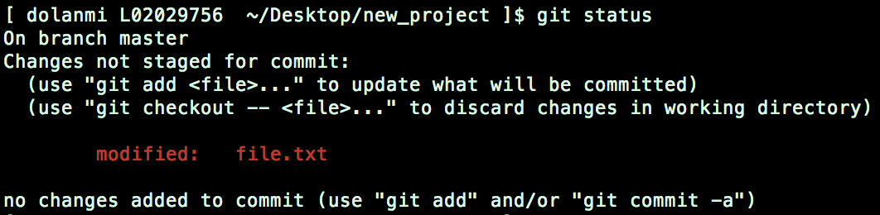
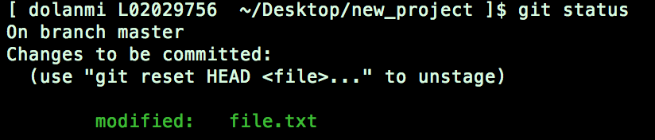
Which files were changed and where do they sit in the three tree?
git status – allows one to see where files are in the three tree scheme
Repository
commit
Staging index
add
working

Slide 27
Good news!
git init
git status
git log
git add
git commit
git diff
git rm
git mv
75% of the time you’ll be using
only these commands

Slide 28

branching
allows one to try new ideas
If an idea doesn’t work, throw away the branch. Don’t have to undo many changes to master branch
If it does work, merge ideas into master branch.
There is only one working directory

Slide 29
Branching and merging example
SHA
= a commit
HEAD
master
Y4f7uiPRRo
Pu87rRi4DD
Qs2o0k64ja
i7Ewd37kL9
he8o9iKlreD
kle987yYieo
mN34i4uwQ
h4Rt5uEl9p
Ge8r67elOp
new branch
HEAD
changes from new
branch merged into
master

Slide 30
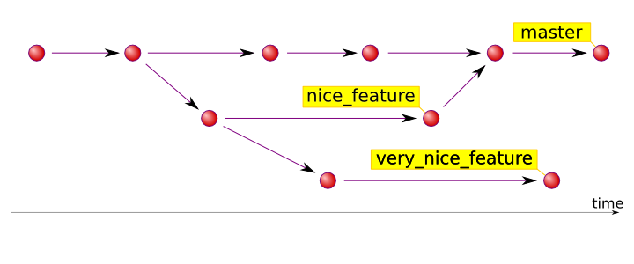
Source: http://hades.github.io/2010/01/git-your-friend-not-foe-vol-2-branches/

Slide 31
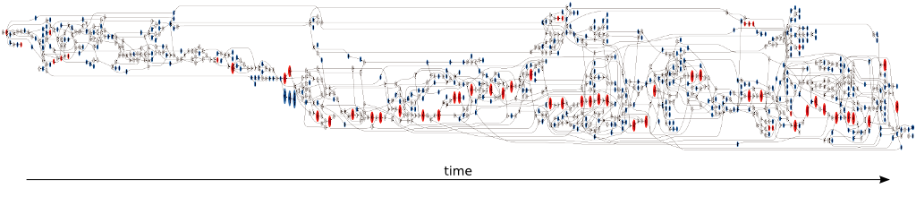
16 forks and 7 contributors to the master branch
red - commits pointed to by tags
blue - branch heads
white - merge and bifurcation commits.
Source: https://www.tablix.org/~avian/blog/archives/2014/06/vesna_drivers_git_visualization/

Slide 32

In which branch am I?
git branch

Slide 33

How do I create a new branch?
git branch new_branch_name
Note: At this point, both HEADs of the branches are pointing to the same
commit (that of master)

Slide 34

How do I switch to new branch?
git checkout new_branch_name
At this point, one can switch between branches, making commits, etc. in either
branch, while the two stay separate from one another.
Note: In order to switch to another branch, your current working directory
must be clean (no conflicts, resulting in data loss).

Slide 35
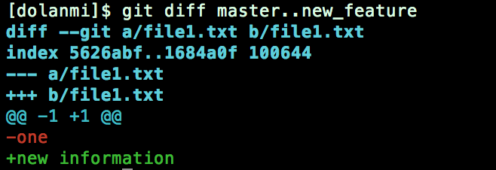
Comparing branches
git diff first_branch..second_branch

Slide 36
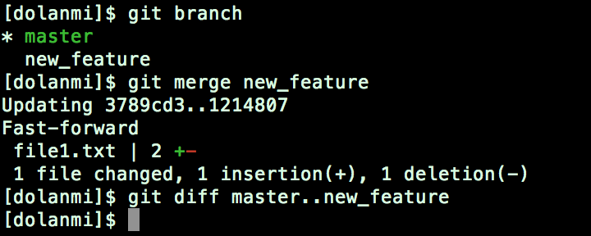
How do I merge a branch?
From the branch into which you want to merge another branch….
git merge branch_to_merge
Note: Always have a clean working directory when merging

Slide 37
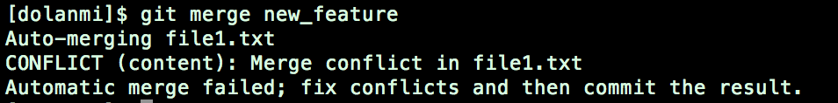
merge conflicts
What if there are two changes to same line in two different commits?
file1.txt
file1.txt
apple
banana
master new_feature

Slide 38
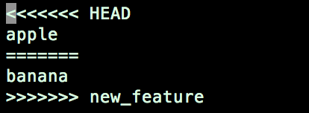
Resolving merge conflicts
Git will notate the conflict in the files!
Solutions:
Abort the merge using git merge –abort
Manually fix the conflict
Use a merge tool (there are many out there)

Slide 39
Tips to reduce merge pain
merge often
keep commits small/focused
bring changes occurring to master into your branch frequently (“tracking”)

Slide 40
What is ?

Slide 41
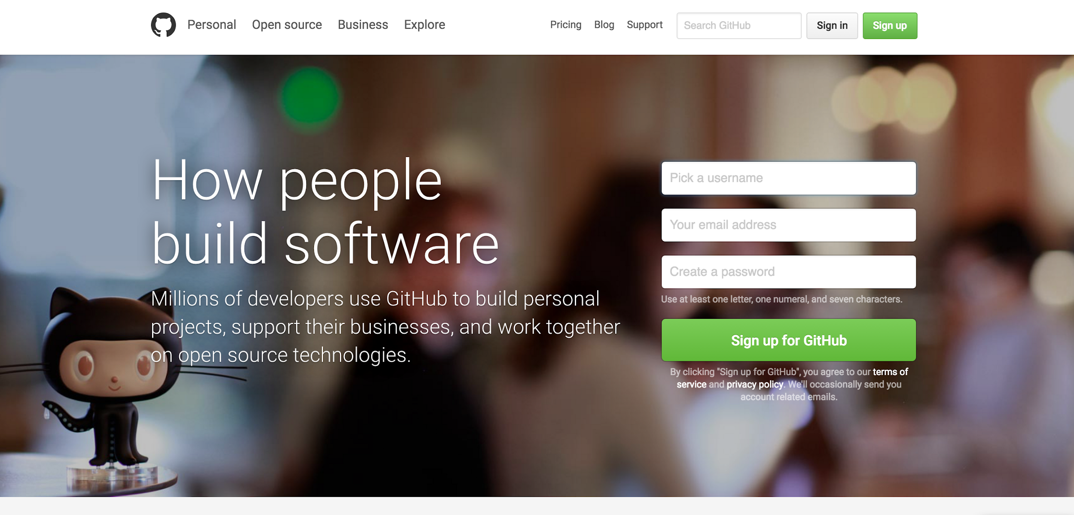

Slide 42
GitHub
a platform to host git code repositories
http://github.com
launched in 2008
most popular Git host
allows users to collaborate on projects from anywhere
GitHub makes git social!
Free to start

Slide 43
GitHub
remote
server
fork
Forked branch
master
pull request
pull/
fetch
someone
else’s master
push
Local
origin/master “branch”
push
origin/master references remote server branch and tries to stay in sync
merge
merge
repo
checkout
commit
Stage
add
Working directory

Slide 44
Important to remember
Sometimes developers choose to place repo on GitHub as a centralized place where everyone commits changes, but it doesn’t have to be on GitHub

Slide 45
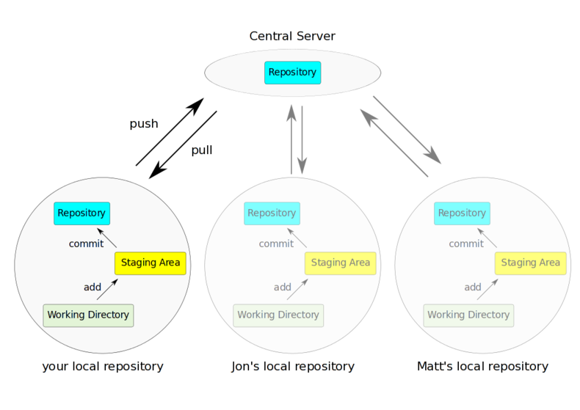
Source: http://bit.ly/1rvzjp9

Slide 46
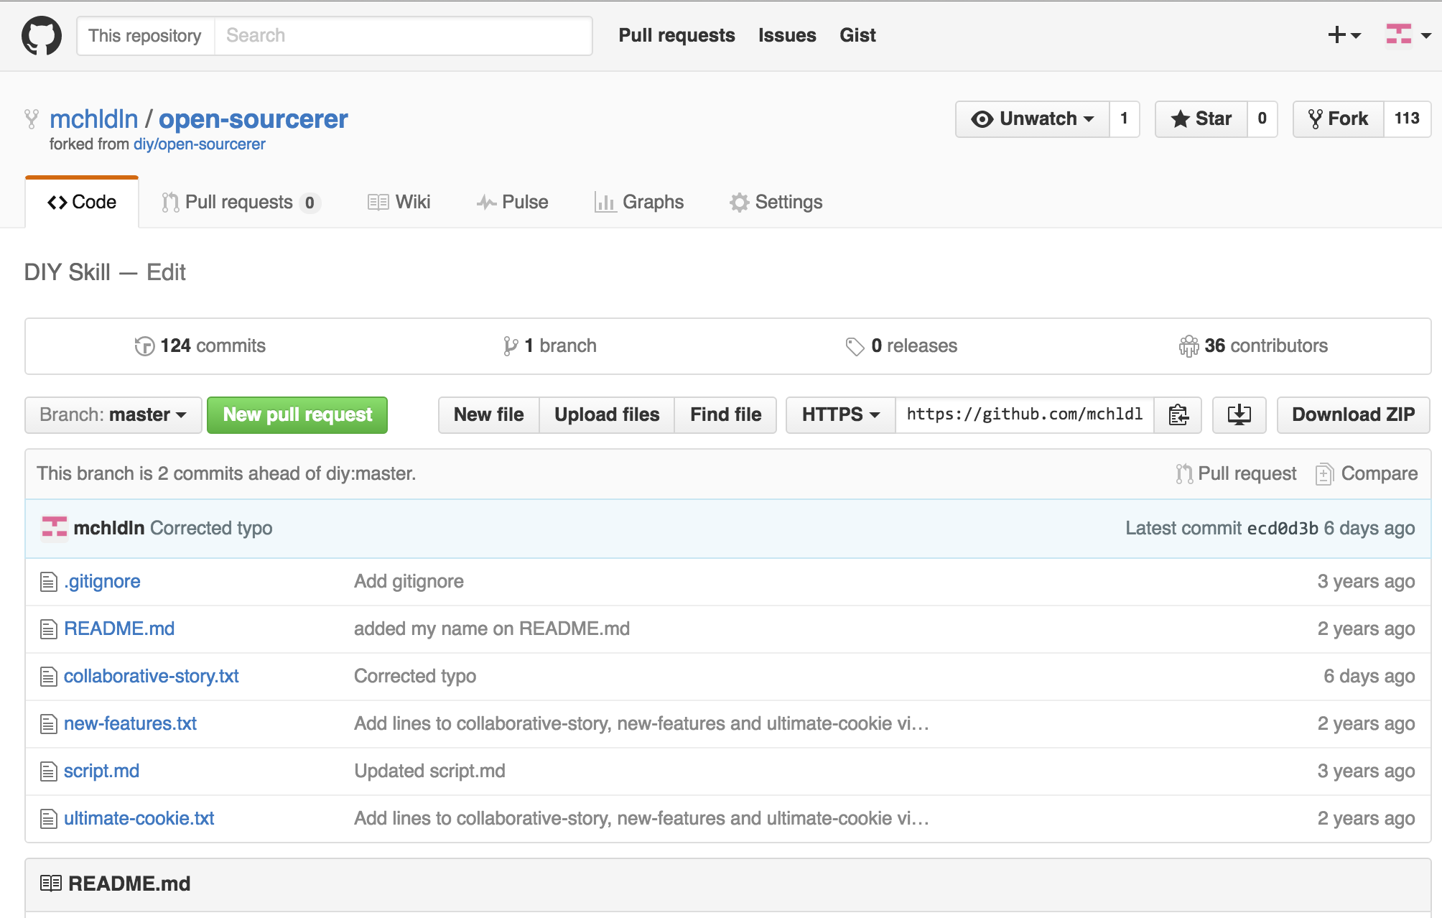

Slide 47
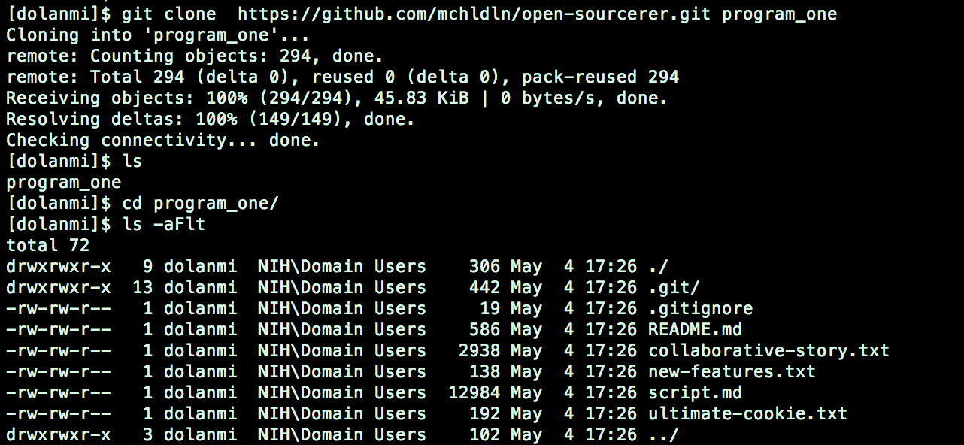
Copying (cloning) files from remote repo to local machine
git clone URL <new_dir_name>

Slide 48
GitHub
remote
server
fork
Forked branch
master
pull request
pull/
fetch
someone
else’s master
push
Local
origin/master “branch”
push
merge
clone
repo
checkout
commit
Stage
add
Working directory

Slide 49
How do I link my local repo to a remote repo?
git remote add <alias> <URL>
Note: This just establishes a connection…no files are copied/moved
Note: Yes! You may have more than one remote linked to your local
directory!
Which remotes am I linked to?
git remote

Slide 50
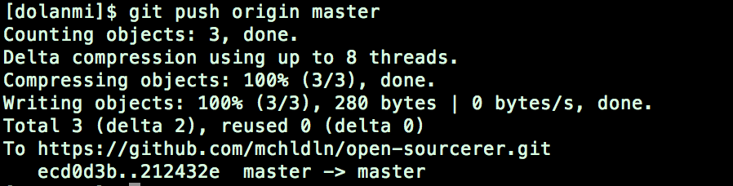
Pushing to a remote repo
git push local_branch_alias branch_name

Slide 51
Fetching from a remote repo
git fetch remote_repo_name
Fetch in no way changes a your working dir or any commits that you’ve made.
Fetch before you work
Fetch before you push
Fetch often
git merge must be done to merge fetched changes into local branch

Slide 52
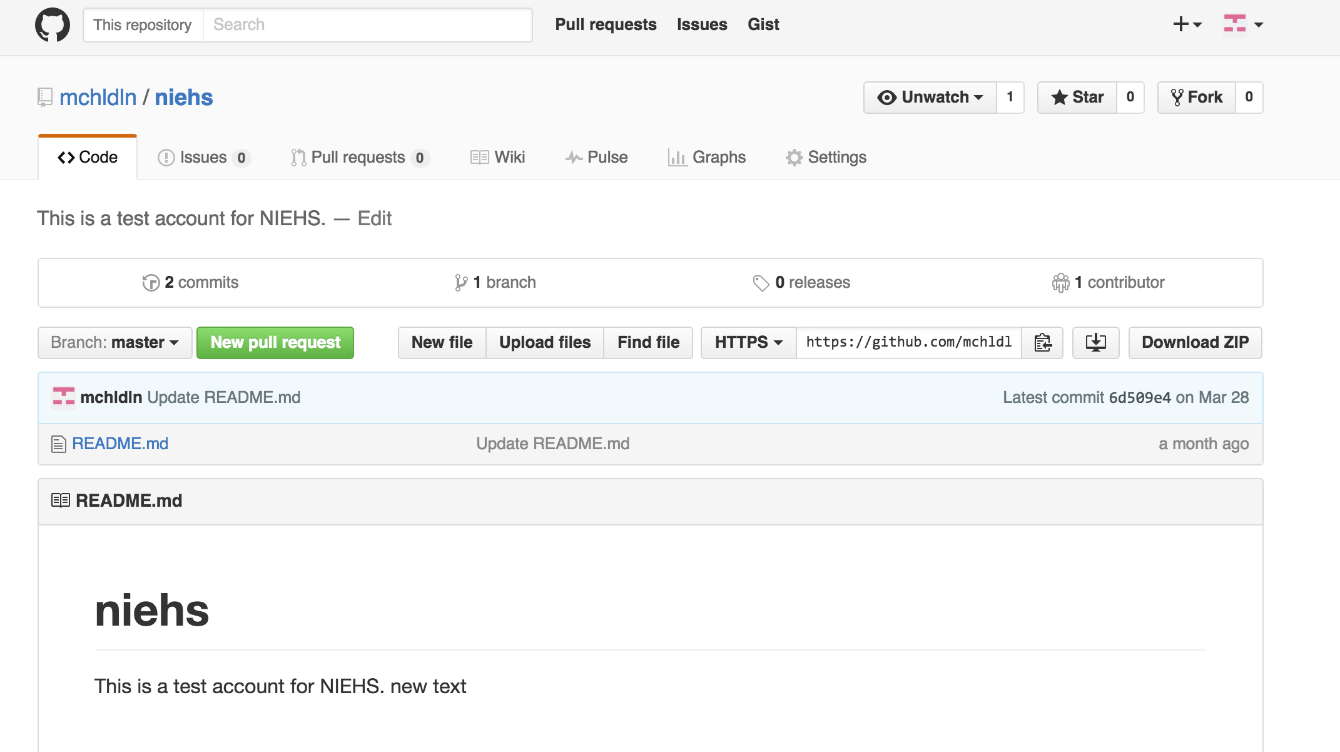
Collaborating with Git

Slide 53
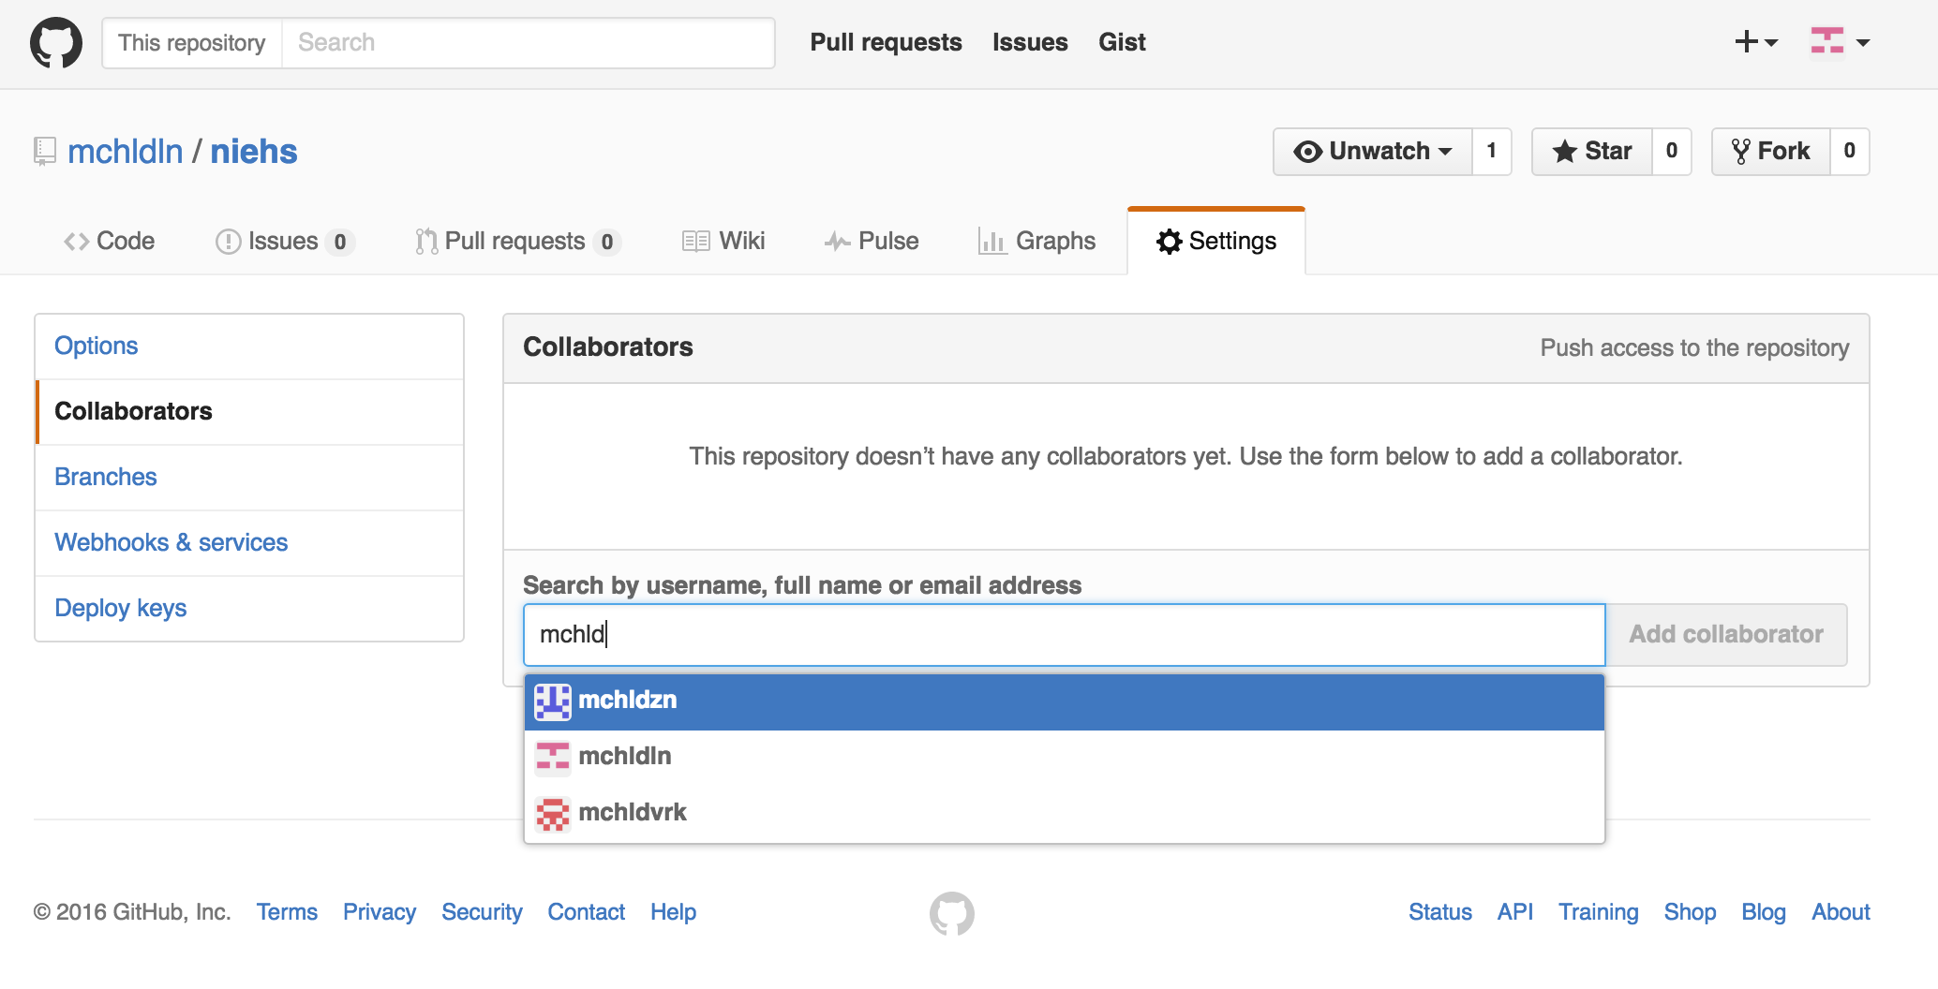
Collaborating with Git
Email sent along with link; collaborator has read/write access.
Everyone has read access
If you want write access and you haven’t been invited, “fork” the repo

Slide 54
GitHub
remote
server
fork
Forked branch
master
pull request
pull/
fetch
someone
else’s master
push
Local
origin/master “branch”
push
merge
merge
repo
checkout
commit
Stage
add
Working directory

Slide 55
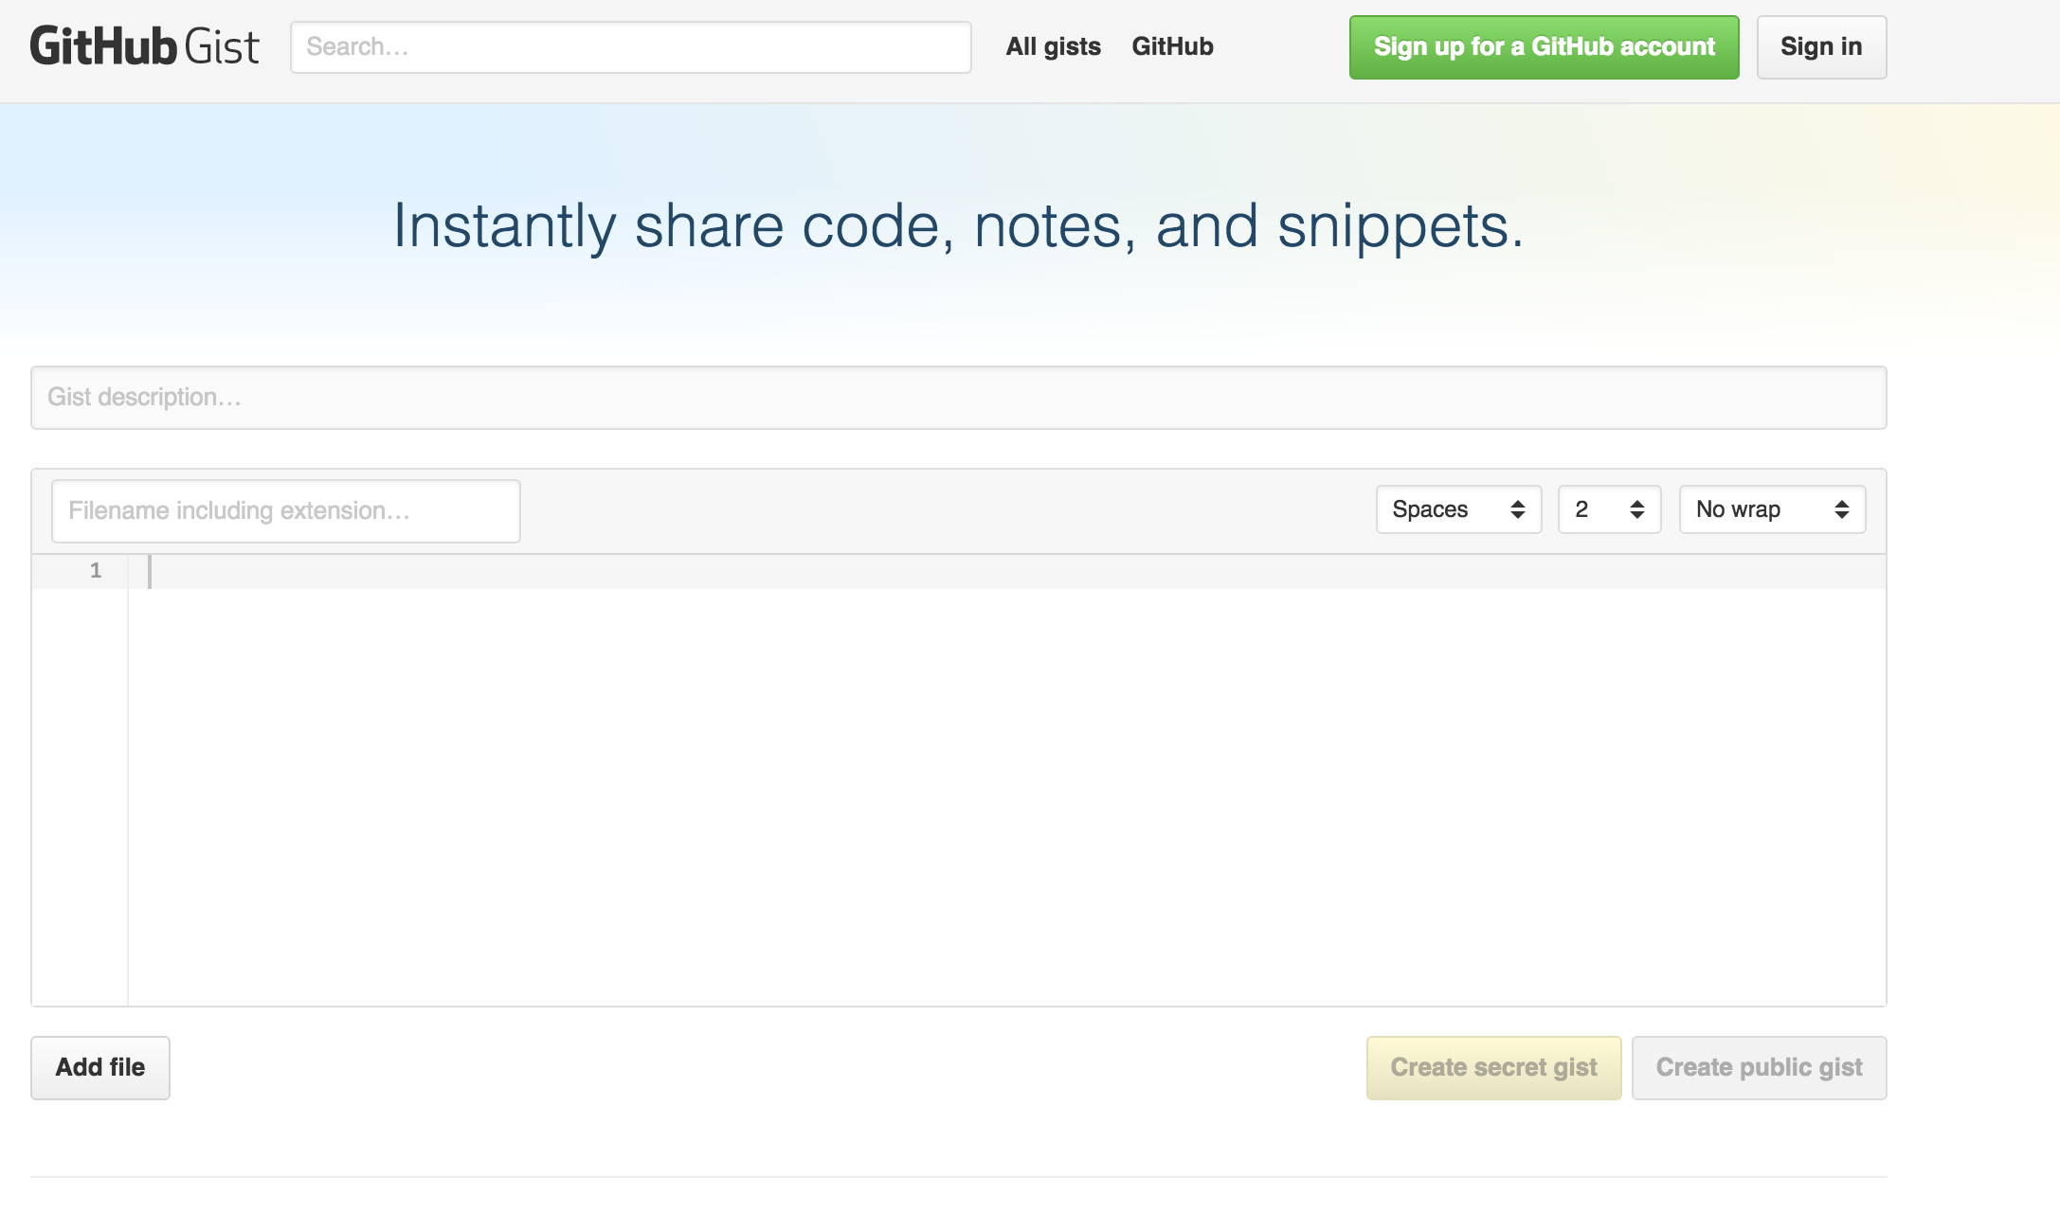
GitHub Gist
https://gist.github.com/

Slide 56
Good resources
Git from Git: https://git-scm.com/book/en/v2
A guided tour that walks through the fundamentals of Git:
https://githowto.com
Linus Torvalds on Git:
https://www.youtube.com/watch?v=idLyobOhtO4
Git tutorial from Atlassian:
https://www.atlassian.com/git/tutorials/
A number of easy-to-understand guides by the GitHub folks
https://guides.github.com

Slide 57
Renaming and deleting branches
git branch –m/--move old_name new_name
git branch –d branch_name
Note: Must not be in branch_name
Note: Must not have commits in branch_name unmerged in branch from which you are deleting
git branch –D branch_name
Note: If you are *really* sure that you want to delete branch with commits

Slide 58
Thank you ☺

